Slide 1
Computer Architecture
Reference:
Mano, “Logic and Computer Design Fundamentals”, and “Computer System Architecture”
MIT lecture Notes
Some slides are taken from the website:
https://www.youtube.com/watch?v=qcBIvnQt0Bw&list=PLiwt1iVUib9s2Uo5BeYmwkDFUh70fJPxX
1
Computer Architecture Module Content
Central Processing Unit Architecture
  Design Approaches [Stack – Pipelining – Interrupt – Processor Organization
– Registers Organization]
  Instruction Set Architecture [Instruction Format – Addressing modes – Data Transfer and Manipulation]
  Example architectures (e.g., CISC, RISC)
Timing, Clock Parameters, and Processor Performance
Memory Hierarchy
  Main Memory
  Cache Memory
  Virtual Memory
2
2

Slide 2
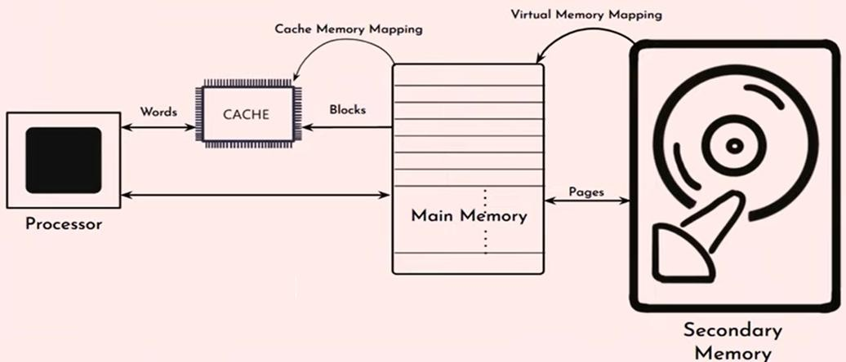
Memory Hierarchy (The Big Picture )
Technology:
SRAM
DRAM
Disk
3
Principle of locality
Analysis of a large number of typical programs has shown that the references to memory at any given interval of time tend to be confined within a few localized areas in memory. This phenomenon is known as the locality of reference.
Programs access a relatively small portion of their address space at any time.
  Spatial locality
  Temporal locality
4

Slide 3
Principle of locality
Spatial locality
  Items near those accessed recently are likely to be accessed soon
  e.g., sequential instruction access, array data
Temporal locality
  Items accessed recently are likely to be accessed again soon
  e.g., instructions in a loop, subroutines
6
Cache Memory
7

Slide 4
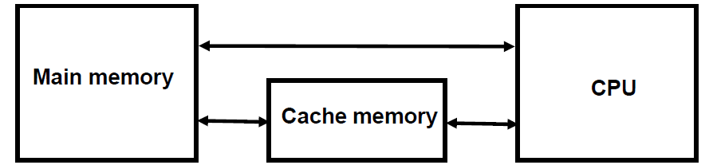
Cache Memory
Cache is a fast, small-capacity memory that should hold the information most likely to be accessed.
8
Cache Memory Terminologies
Block: unit of copying (Usually multiple words)
Hit: If accessed data is present in the upper level
  Hit time
  Hit ratio: number of hits/total number of access to the memory = hits/accesses
Miss: If accessed data is absent, Then block copied from lower level
  Time taken called miss penalty
  Miss ratio: misses/accesses = 1 – hit ratio
9

Slide 5
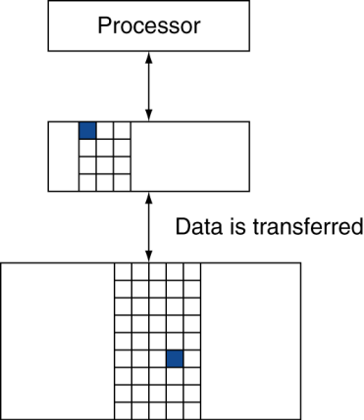
Cache Memory Terminologies
Hit time: time to access the upper level of the memory hierarchy.
Includes the time needed to determine whether the access is a hit or a miss.
Block of data (unit of data copy)
_{n}th
Miss penalty: time to replace a block in the upper level with the corresponding block from the lower level, plus the time to deliver the required data to the processor.
(n+1)^{th}
11
Cache Memory Access
All the memory accesses are directed first to the Cache:
  If the word is in Cache → Access cache to provide it to the CPU.
  If the word is not in Cache → Bring a block (or a line) including that word
to replace a block now in the Cache.
⁈ How can we know if the word that is required is there?
⁈ If a new block replaces one of the old blocks, which one should we choose?
12

Slide 6
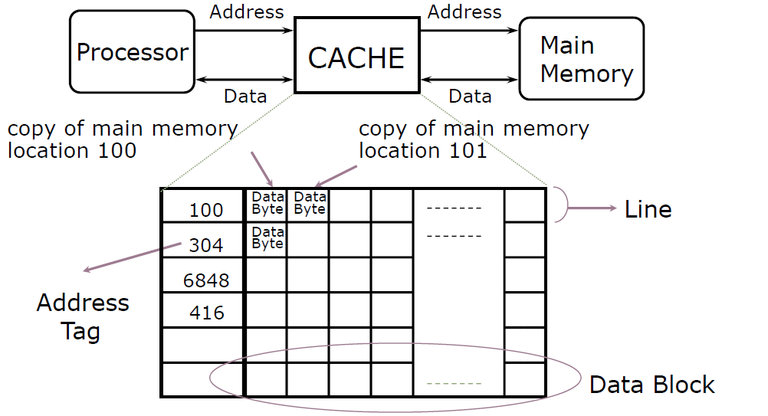
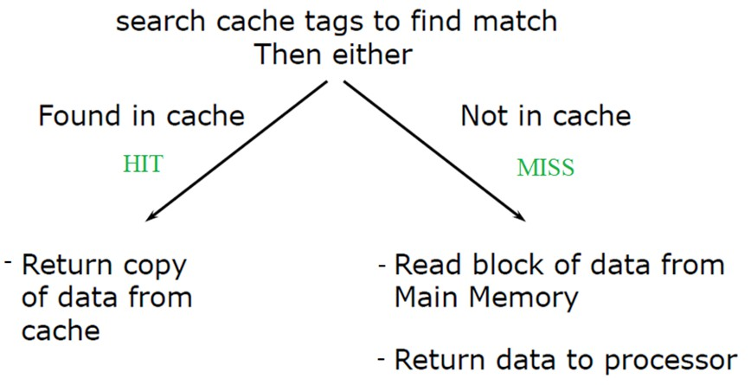
Inside a Cache
(Block)
13
Cache Algorithm (Read)
14

Slide 7
Cache Algorithm (Write)
There are three possible write actions from which we can select:
  Write the result into the main memory.
write-through
This uses the main memory write time and can slow down processing.
2. Write the result into the cache.
write-back
To avoid a write-back to the main memory on every miss, an additional bit is added to each cache block. This bit called the dirty bit, is a 1 if the line in the cache has been written and a 0 if it has not been written.
Write-back to main memory must be performed only if the dirty bit is 1.
3. Write the result into both the main memory and the cache.
If it Hits it again in the cache or misses it, it is stored correctly.
15
Cache Example
The access time of cache memory is 100 ns and the miss penalty is 1100 ns. The hit ratio is 0.9.
what is the average access time of the system?
Solution:
Average memory access time (AMAT) = Hit ratio * Hit time + Miss rate * Miss penalty
= 0.9 * 100 + 0.1 * 1100 = 200 ns
16

Slide 8

Memory and Cache Mapping
The basic characteristic of cache memory is its fast access time. Therefore, very little or no time must be wasted when searching for words in the cache.
The transformation of data from main memory to cache memory is referred to as a mapping process. There are three types of mapping procedures
  Direct mapping
  Associative mapping
  Set-associative mapping
17
1. Direct Mapping
Only one specific location in the cache
can contain the word from a specific main memory location
18

Slide 9
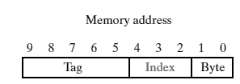
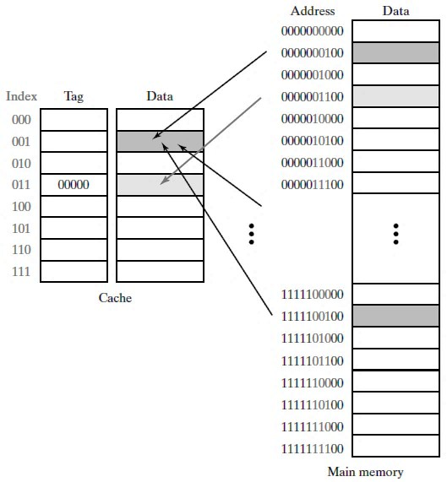
1. Direct Mapping Example1
Cache:
2³ × 32-bit words (3-bit addresses)(4-Byte Block)
Main Memory:
1 KB (10-bit addresses)
Least significant bits → choose Byte Middle bits → choose block
Most significant bits → Tag
Address bits:
Number of bytes/block → Byte Number of Cache address bits → Index
Remaining bits in Main Memory → Tag
19
1. Direct Mapping
Example1
20

Slide 10

1. Direct Mapping Example2
A digital computer has a memory unit of 64K ×16-bit word and a cache memory of 1K words. The cache uses direct mapping with a block size of four words.
  How many bits are there in the tag, index, and word fields of the address format?
Solution:
64K ×16 Main Memory → 16-bit addresses, 16-bit data cache 1K → 8-bit addresses, block: 4 memory words
21
Direct Mapping
  Advantage:
    Fast
  Disadvantages
    Cache miss can happen due to instructions with the same index while the cache of other indexes are empty.
22

Slide 11
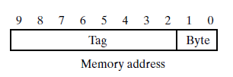
2. Associative mapping
any location in memory
can be mapped to any location in the cache.
23
Associative mapping Example1
  Cache:
2³ × 32-bit words (3-bit addresses) (4-Byte Block)
  Main Memory:
1 KB (10-bit addresses)
The tag will be the full main memory block address.
24

Slide 12
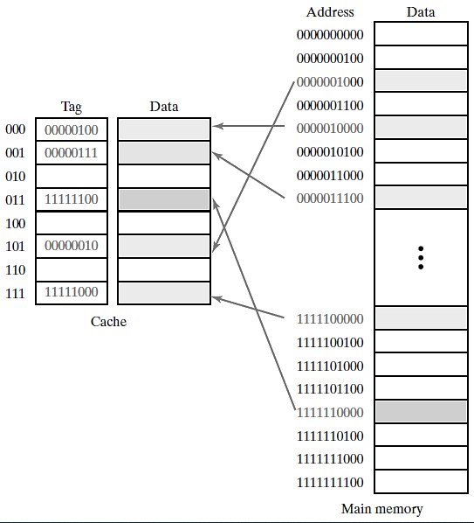
2. Associative mapping Example1
25
Associative mapping
  Disadvantage:
    Slow: CPU must compare address with all cache tags. (Hit time ↑)
  Advantages
    No misses when any cache block is empty (miss rate ↓)
26

Slide 13
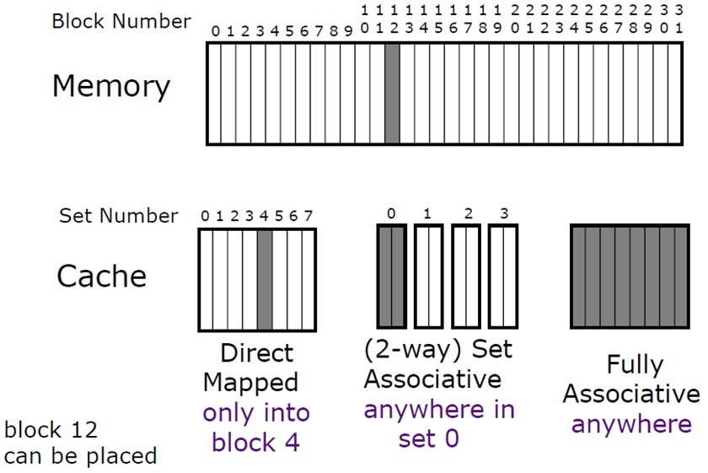
3. Set-associative mapping
A compromise between a direct-mapped cache and a fully associative cache.
Lower-order address bits act as direct mapping; but instead of having one location, there is a set of s locations.
  s = 2, Two-Way Set-associative Cache
  s = 4, Four-Way Set-associative Cache
27
Placement Policy
Direct mapping: Memory address
2-bit Tag, 3-bit Index
2-way set associative: Memory address
3-bit Tag, 2-bit Index
Fully associative: Memory address 5-bit Tag
28

Slide 14
Replacement Policy
Which block from a set should be evicted?
Random
First In, First Out (FIFO) (called: Round-Robin)
Least Recently Used (LRU)
29
Virtual Memory
36

Slide 15
Memory Hierarchy (The Big Picture )
37
Virtual Memory
Virtual memory is a memory management technique where secondary memory can be used as if it were a part of the main memory. Virtual memory is a common technique used in a computer's operating system (OS).
Problem:
Not enough RAM
38

Slide 16
Virtual Memory Terminologies
In a memory hierarchy system, programs and data are first stored in auxiliary memory.
Portions of a program or data are brought into main memory as they are needed by the CPU.
Virtual memory is a concept used in some large computer systems that permit the user to construct programs as though a large memory space were available, equal to the totality of auxiliary memory.
Virtual memory gives programmers the illusion that they have a very large memory at their disposal, even though the computer has a relatively small main memory.
Virtual memory is a common technique used in a computer's operating system (OS).
39
Virtual Memory Terminologies
An address used by a programmer will be called a virtual address, and the set of such addresses is the address space.
An address in the main memory is called a location or physical address. The set of such locations is called the memory space.
Thus the address space is the set of addresses generated by programs as they reference instructions and data; the memory space consists of the actual main memory locations directly addressable for processing.
In most computers that don’t use a virtual memory system, the address and memory spaces are identical. The address space is allowed to be larger than the memory space in computers with virtual memory.
40

Slide 17
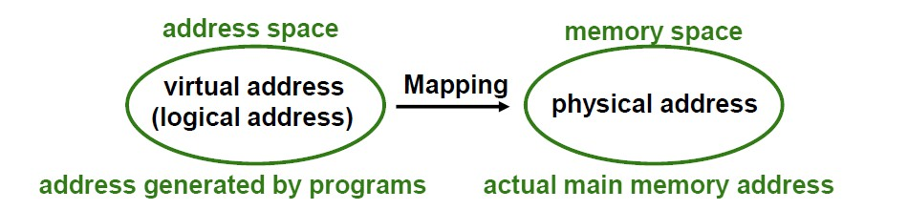
Address Space and Memory Space
Each Program will “see” a memory size of the virtual address space.
Address Space (Logical) and Memory Space (Physical)
41
Virtual Memory Mapping
Each address that is referenced by the CPU goes through an address mapping from the virtual address to a physical address in the main memory.
A virtual memory system provides a mechanism for translating program-
generated addresses into correct main memory locations.
This is done dynamically, while programs are being executed in the CPU.
The translation or mapping is handled automatically by the hardware by means of a mapping table.
42

Slide 18
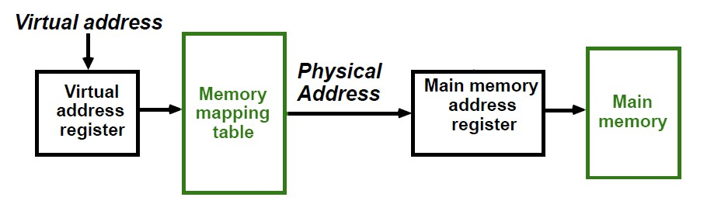
Virtual Memory
Give the programmer the illusion that the system has a very large memory, even though the computer actually has a relatively small Main Memory.
The job of the software and hardware that implement virtual memory is to map
each virtual address for each program into a physical address in the main memory.
Mapping enables a computer to treat
secondary memory as though it were Main Memory
The mapping is handled automatically by the hardware
by means of a mapping table.
43
Virtual Memory Mapping Table
Address Mapping:
44

Slide 19
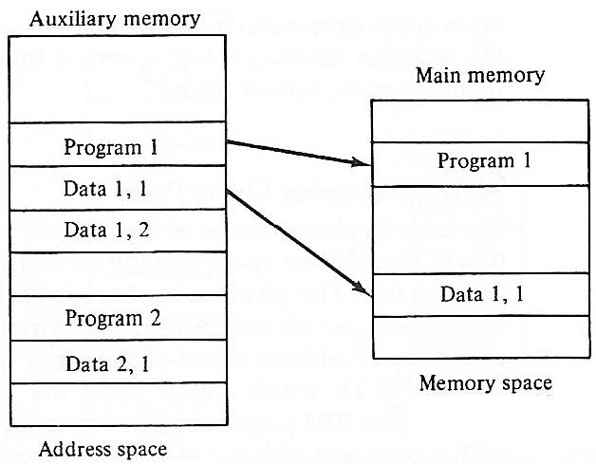
Virtual Memory Illustration Example
Relation between address and memory space in a virtual memory system.
47
Address Mapping
The address space is broken down into groups of equal size called pages.
The programs are considered to be split into pages. Portions of programs are moved from auxiliary memory to main memory in records equal to the size of a page.
49

Slide 20
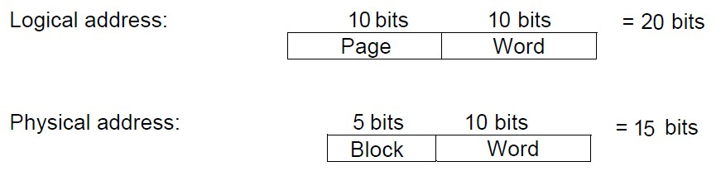
Address Mapping Example
Consider a computer with a main-memory capacity of 32K words. 15 bits are needed to specify a physical address in memory since 32K words= 2¹⁵ words.
Suppose that the computer has available auxiliary memory for storing 2²⁰ words = 1M words. Thus auxiliary memory has a capacity for storing information equivalent to the capacity of 32 main memories.
A table is needed to map a virtual address of 20 bits to a physical address of 15 bits. The mapping is a dynamic operation, which means that every address is translated immediately as a word is referenced by the CPU.
50
Address Mapping Example
If the information in address space and memory space are each divided into groups of fixed size.
  For example:
page and block consist of 1K words
address space is 2²⁰ word divided into …¹⁰…²⁴. pages. main memory is 2¹⁵ word divided into …³²… blocks.
52

Slide 21
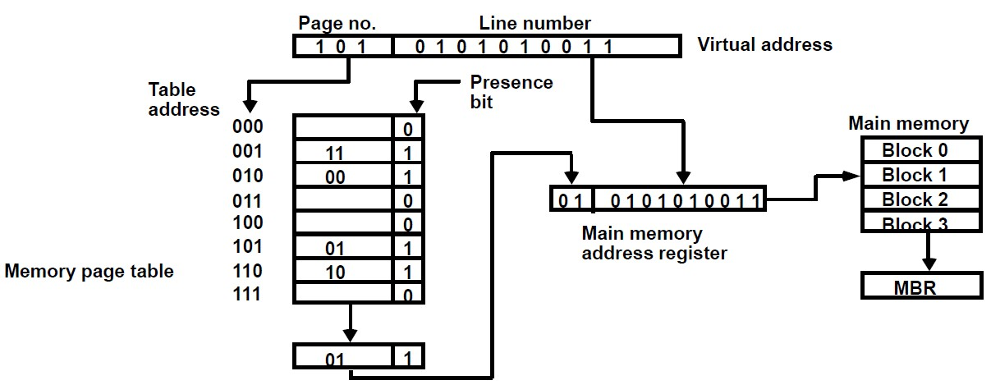
Memory Page Table (Direct Mapping)
54
Associative Memory Page Table
We can observe that the number of pages in auxiliary memory is larger than the number of blocks in the main memory.
In general, a system with n pages and m blocks would require a Memory Page Table of n locations of which up to m blocks will be marked with block numbers, and all others will be empty.
For example, an address space of 1024K words and a memory space of 32K words. If each page or block contains 1K words, the number of pages is 1024, and the number of blocks is 32. The capacity of the memory-page table must be 1024 words and only 32 locations may have a presence bit equal to 1. At any given time, at least 992 locations will be empty and not in use.
58

Slide 22
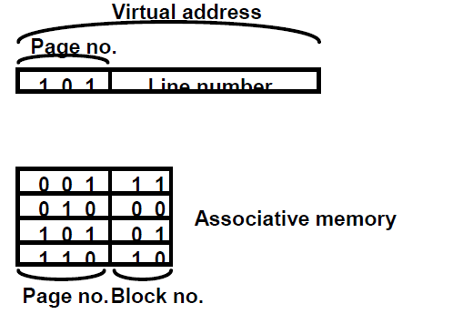
Associative Memory Page Table
A more efficient way to organize the memory page table would be to construct it with a number of words equal to the number of blocks in the main memory.
Using associative memory with each word containing a page number together with its corresponding block number.
So, the memory is fully utilized.
59
Associative Memory Page Table
Each entry in the associative memory array consists of two fields. The first is for storing the page number. The second is for storing the block number.
The page number bits are compared with all page numbers in the page field of the associative memory. If the page number is found, the corresponding block number, being in the same word, is transferred to the main memory address register. If no match occurs, a call to the operating system is generated to bring the required page from auxiliary memory.
60

Slide 23
Memory Page Table
If the presence bit in the word read from the page table is ‘0’:
  It means that the content of the word referenced by the virtual address does not exist in the main memory.
  A call to the operating system is then generated to fetch the required page from auxiliary memory and place it into the main memory before resuming computation.
61
Replacement Policy
First In, First Out (FIFO)
Least Recently Used (LRU)
62

